Slide 1
FIFA PLAYER ANALYSIS
BI Lab Mini-Project
Project Guide : Prof. Jaya Jeswani
Aditi Pathare - XIEIT181938 Swizal Dhanu - XIEIT2019032001

Slide 2
Problem Statement :
A FIFA dataset to perform Preprocessing, Exploratory Data Analysis (EDA), Regression, Correlation, Clustering, and Classification to extract important information of different players and their different features.

Slide 3
Implementation :
Regression
Linear Regression
Multiple regression
Attribute Reduction
Clustering
K-Means
K-Medoids
Hierarchical Clustering With Dendrogram
With Average Linkage
With Single Linkage
With Centroid Linkage
With Complete Linkage
Classification
Linear Regression
Random Forest Regression
Player’s Features Analysis with importance
Missing Values
Exploratory Data Analysis
Top 10 Players
Club Players
Geospatial
Scatter Plot
Bar Chart
Line Chart
Histogram
Boxplot
Jointplot - KDE Plot
Correlation
Heatmap Analysis
Individual Analysis

Slide 4
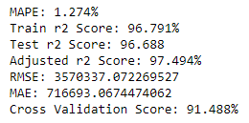
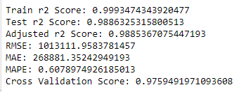
Classification Comparison :
Linear Regression
Random Forest

Slide 5
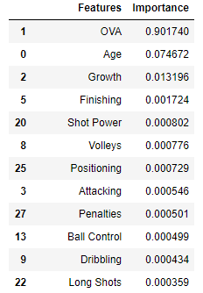
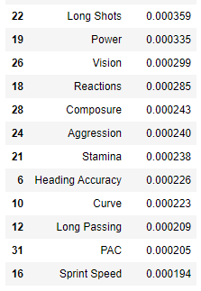
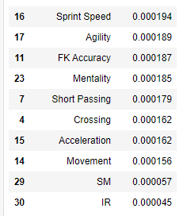
Player’s Features Analysis With Importance :

Slide 6
Conclusion :
Thus, we have analyzed the player’s overall data and got a lot of insights from it. We have utilized data about the attributes of the players from the latest EA Sports FIFA 18- Soccer game. It can be concluded after analysis and visualization that most well-performing players are expected to have high overall score for their good career.

Slide 7


